Slide 1
CENG401 MACHINE LEARNING AND ARTIFICIAL INTELLIGENCE
Assist.Prof.Dr. Murat ŞİMŞEK

Slide 2
OVERVIEW
Assist.Prof.Dr. Murat ŞİMŞEK
murat.simsek@ostimteknik.edu.tr

Slide 3
OVERVIEW
Mid-term exam %30
Final Exam %50
Homework %10

Slide 4
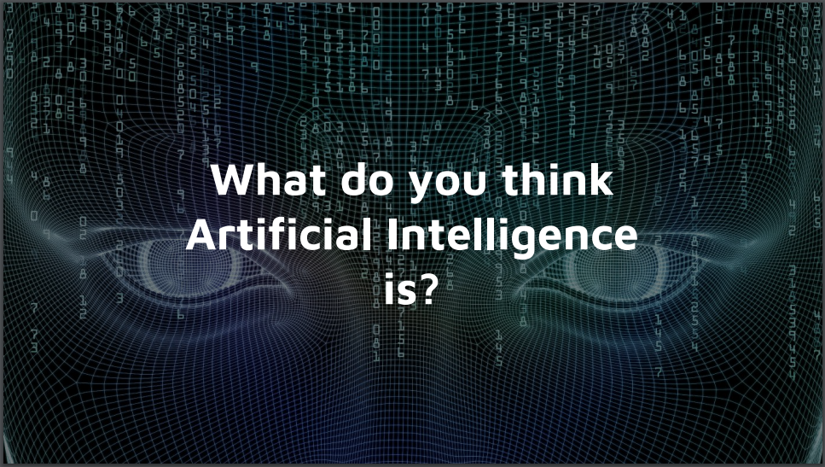

Slide 5
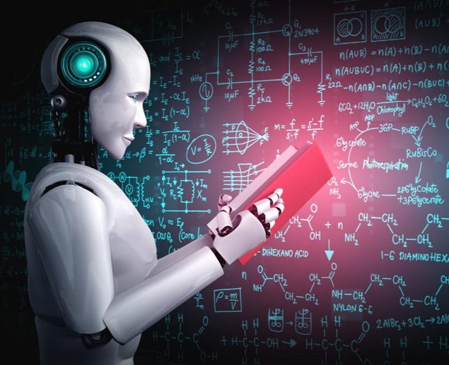
Artificial Intelligence is the development of computer systems
that are able to perform tasks that would require human
intelligence.

Slide 6
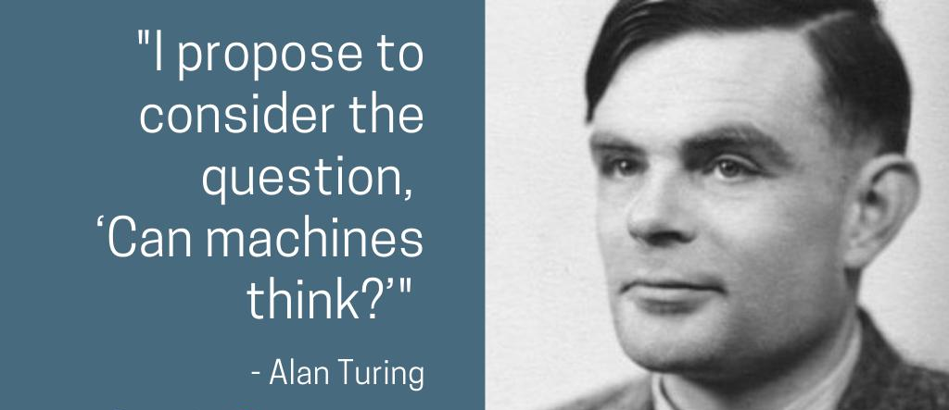
Alan Turing
Notes:
The earliest substantial work in the field of artificial intelligence was done in the mid-20th century by Alan Turing. He asked a famous question about machine.
Turing was a founding father of artificial intelligence and of modern cognitive science, and he was a leading early exponent of the hypothesis that the human brain is in large part a digital computing machine.

Slide 7
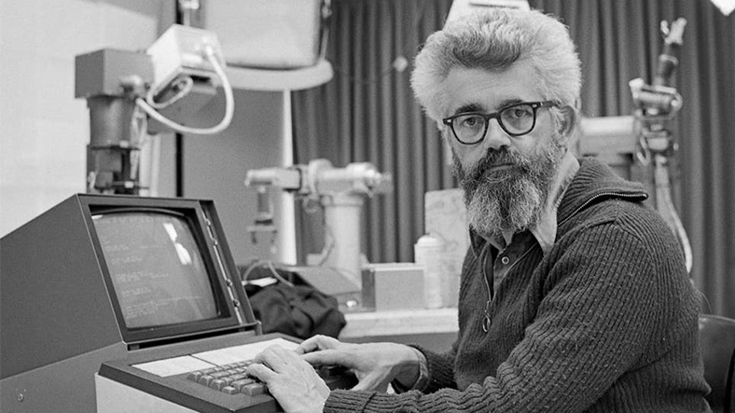
John McCarthy
The term was
introduced by
John McCarthy
in 1956 in the
well-known
Dartmouth
Conference.
John McCarthy (1927-2011)
The father of Artificial Intelligence (1956 Darthmouth Conference)

Slide 8
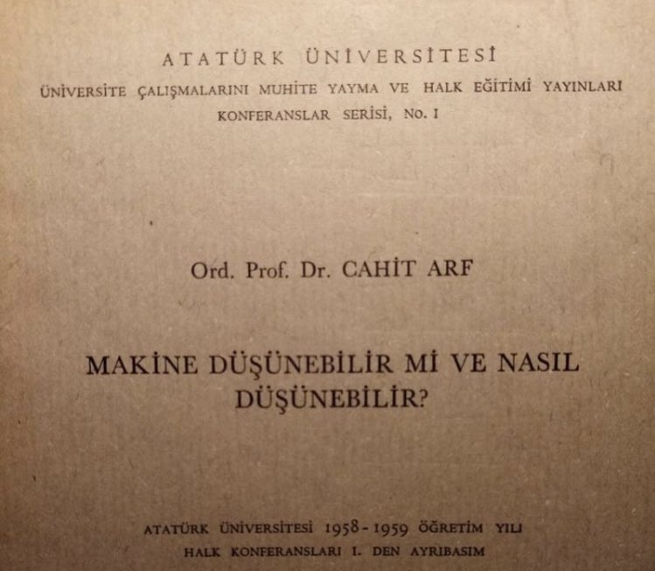
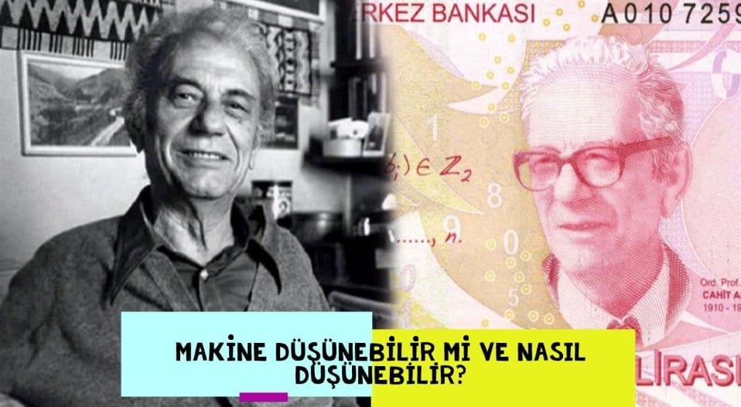
Cahit Arf
Notes:
This is a familiar name. Cahit Arf. He was one of the pioneers of Artificial Intelligence.

Slide 9
What is AI?
Artificial intelligence is the study and design of computing systems that
perceives its environment and takes actions like human beings.
Notes:
The term was introduced by John McCarthy in 1956 in the well-known Dartmouth Conference.

Slide 10
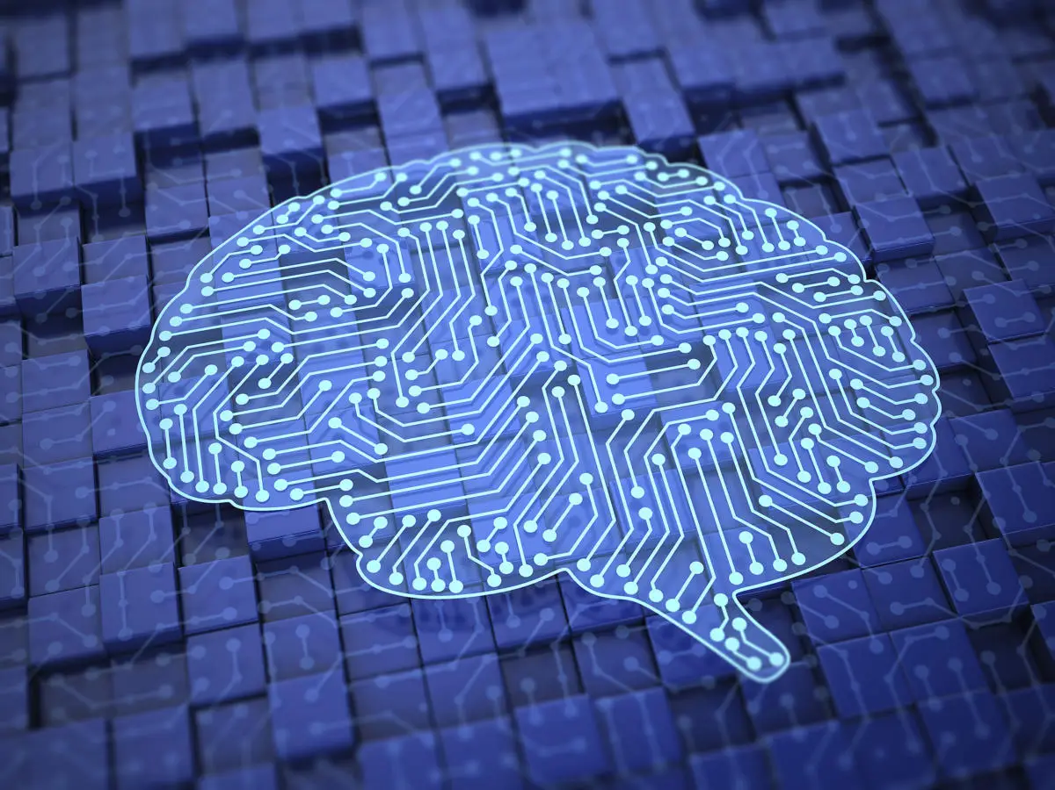
The definitions on top
are concerned with
thought processes and
reasoning, whereas the ones on the bottom
address behavior.
The definitions on the
left measure success in
terms of fidelity to
human performance,
whereas the ones on
the right measure
against an ideal
performance measure,
called rationality.

Slide 11
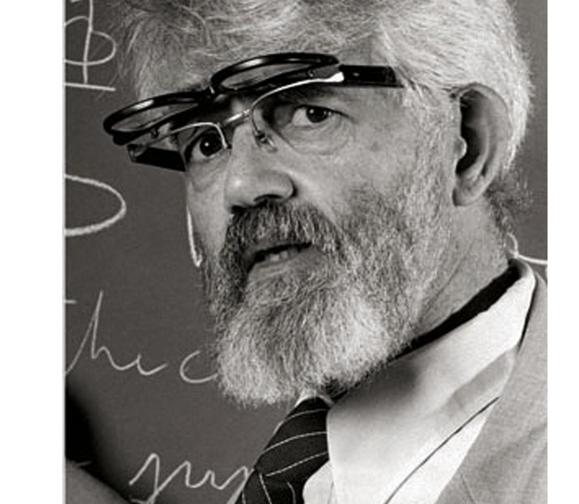
John McCarthy
“If all the features of learning and intelligence are
described down to the finest detail, computers can
simulate them and as a result think like humans.”
John McCarthy

Slide 12
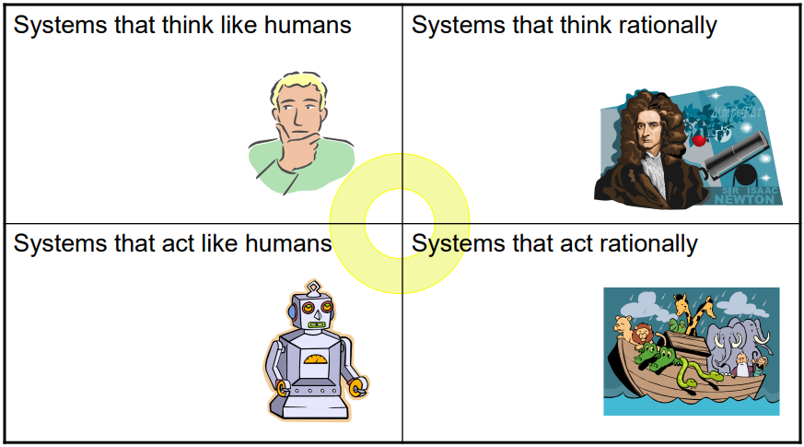
Thinking Humanly
Thinking Rationally
Acting Humanly
Acting Rationally

Slide 13
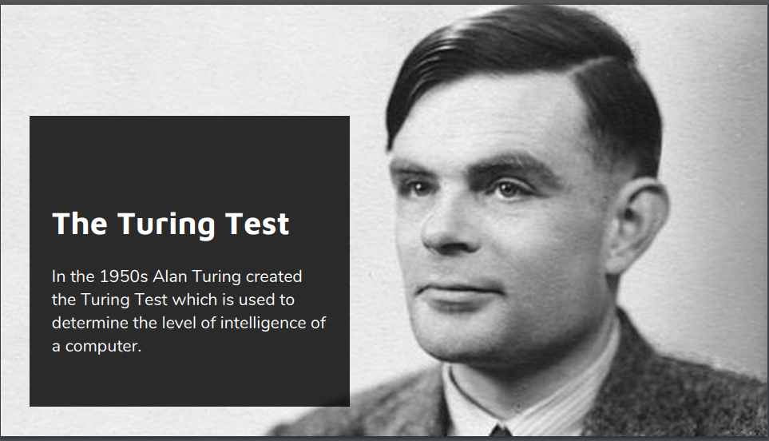
Acting humanly: The Turing Test approach

Slide 14
Acting humanly: The Turing Test approach
A computer passes the test if a human cannot tell whether the written responses come from a person or from a computer.
For now, we note that programming a computer to pass a rigorously applied test provides plenty to work on.
The computer would need to possess the following capabilities:
Machine
Learning
NLP
Knowledge
Representation
Automated
Reasoning

Slide 15
Total Turing Test
Total Turing Test includes a video signal so that the interrogator can test the subject’s perceptual abilities, as well as the opportunity for the interrogator to pass physical objects “through the hatch.” To pass the total Turing Test, the computer will need:
Computer
Vision
Robotics

Slide 16
Thinking humanly: The cognitive modeling approach
If we are going to say that a given program thinks like a human, we must have some way of determining how humans think. We need to get inside the actual workings of human minds.
There 3 ways to do this:
Through
Psychological
Experiments
Through
introspection
Through
Brain imaging

Slide 17
Thinking rationally: The “laws of thought” approach
There are two main obstacles to this approach:
First, it is not easy to take informal knowledge and state it in the formal terms required by logical notation, particularly when the knowledge is less than 100% certain
Second, there is a big difference between solving a problem “in principle” and solving it in practice.

Slide 18
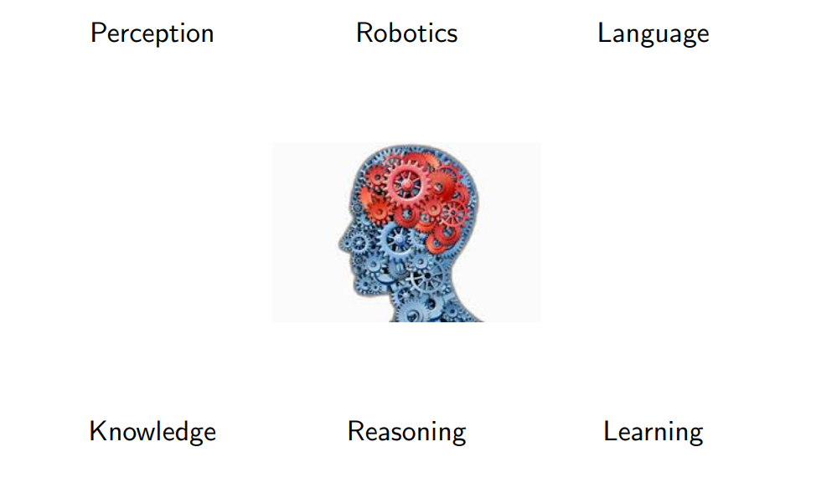
Acting rationally: The rational agent approach

Slide 19
THE FOUNDATIONS OF ARTIFICIAL INTELLIGENCE
Philosophy
Mathematics
Economics
Artificial
Intelligence
Neuroscience
Computer
engineering
Control theory
and cybernetics
Psychology
Linguistics

Slide 20
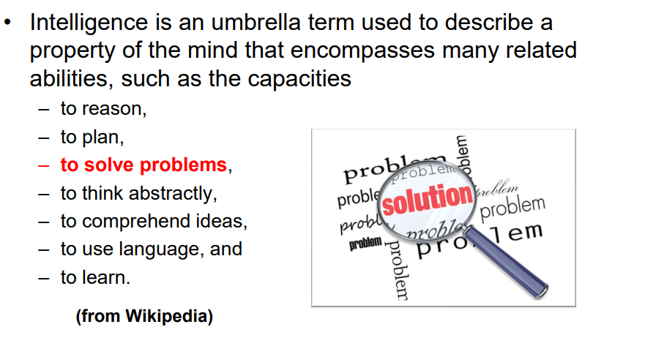
After all, what is intelligence?

Slide 21
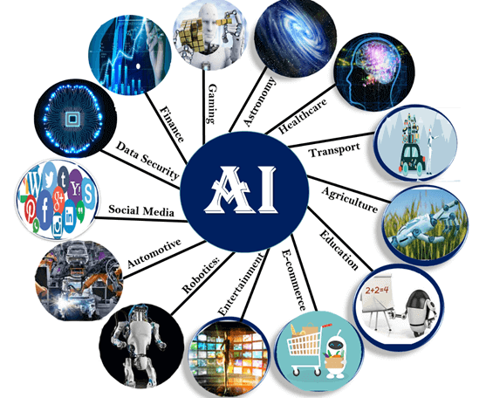
Applications of AI

Slide 22
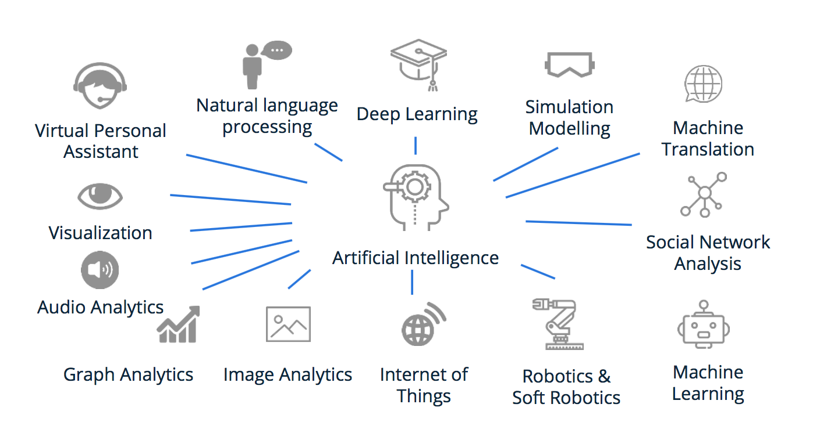
Applications of AI

Slide 23
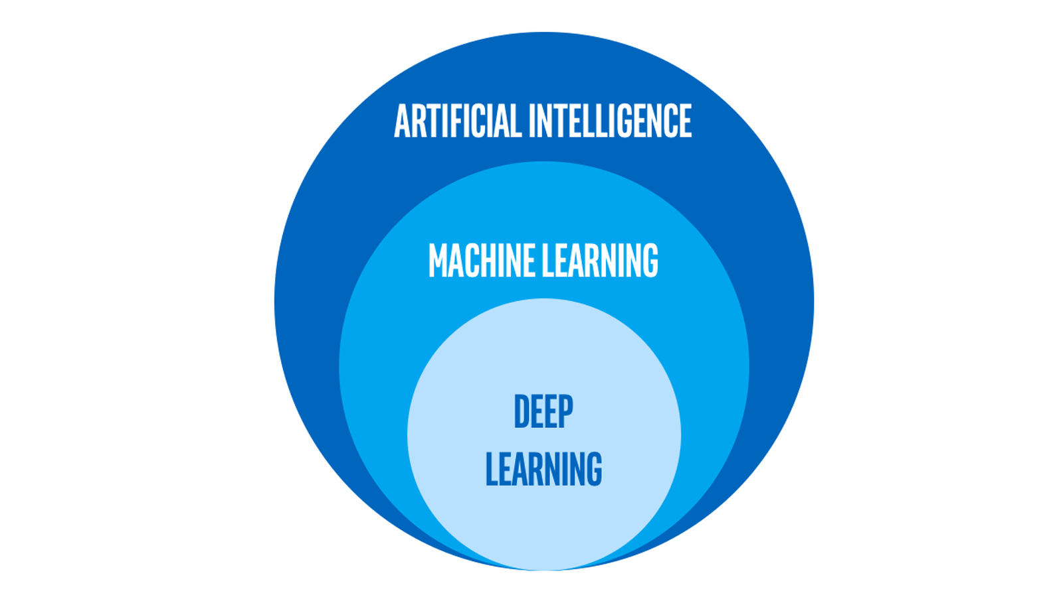
Subclass of AI

Slide 24
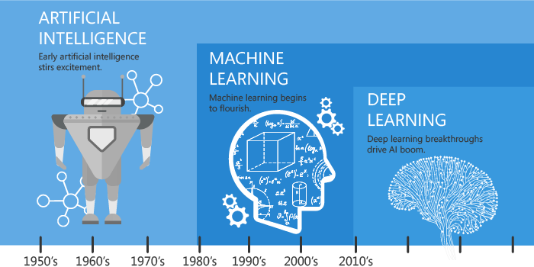
Subclass of AI

Slide 25
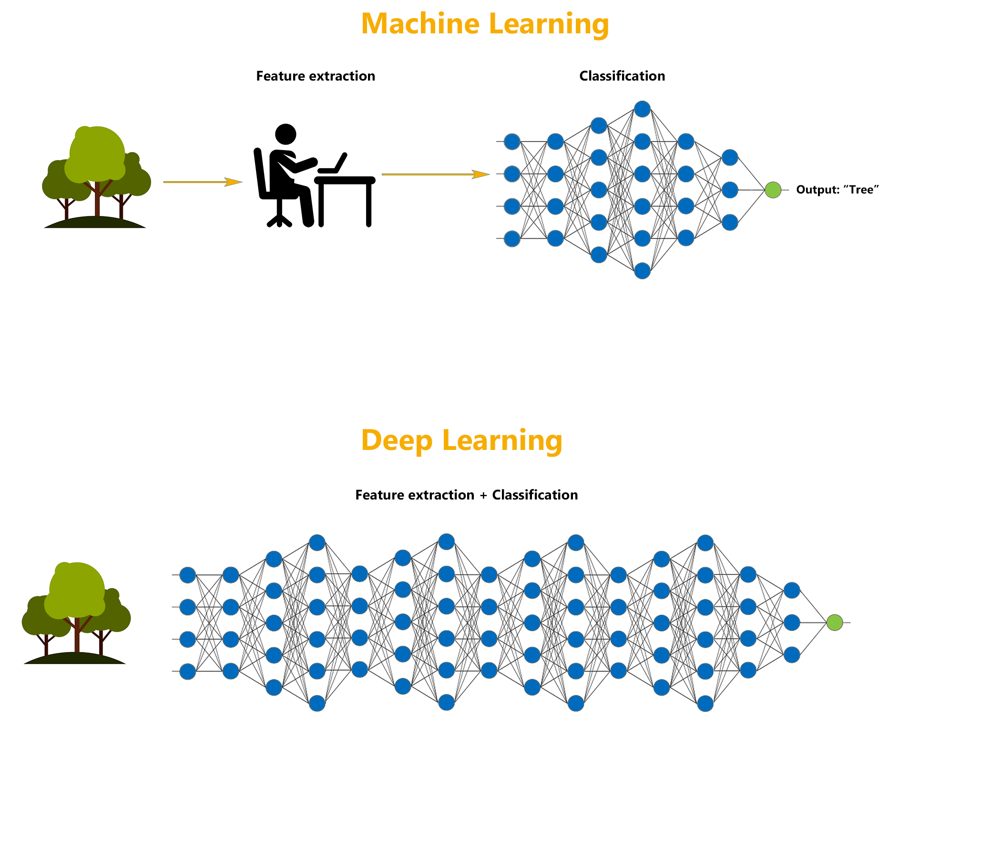
ML vs DL

Slide 26
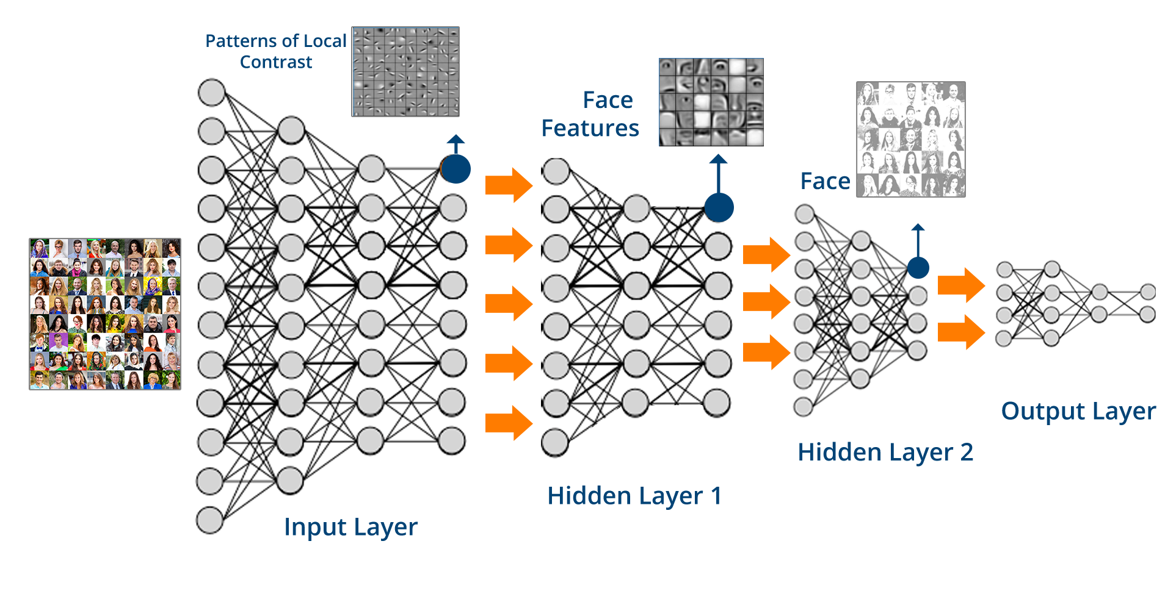
Deep Learning

Slide 27
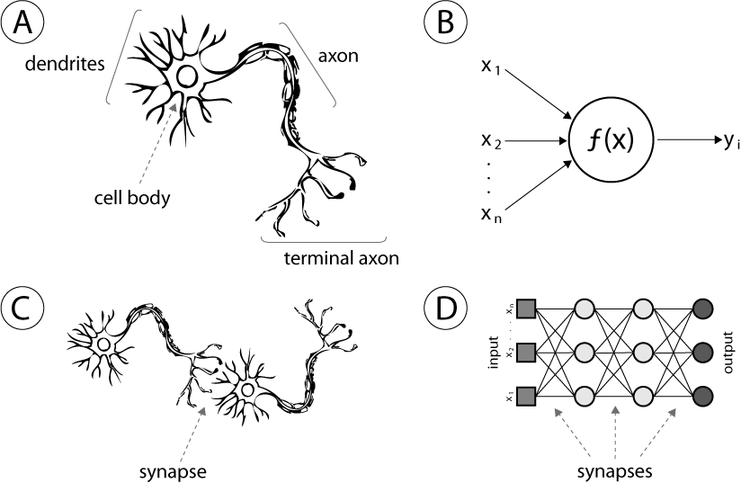
Artificial Neural Network

Slide 28
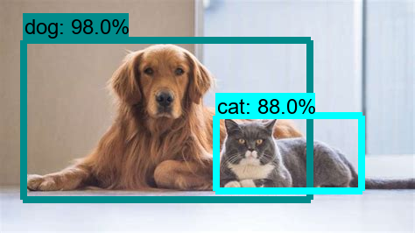
Object Detection and Recognition

Slide 29
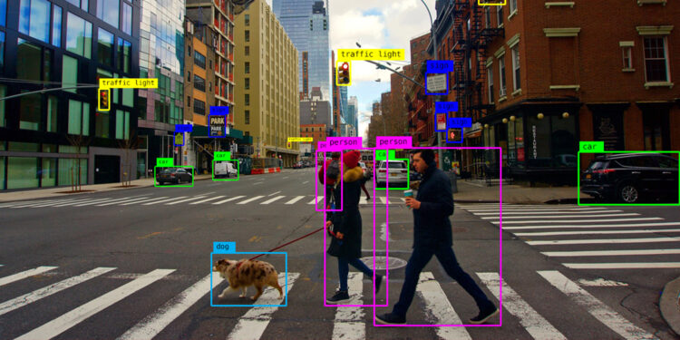
Object Detection and Recognition

Slide 30
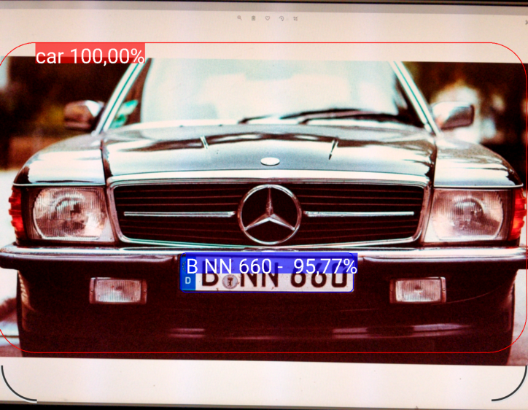
Car Plate Recognition

Slide 31
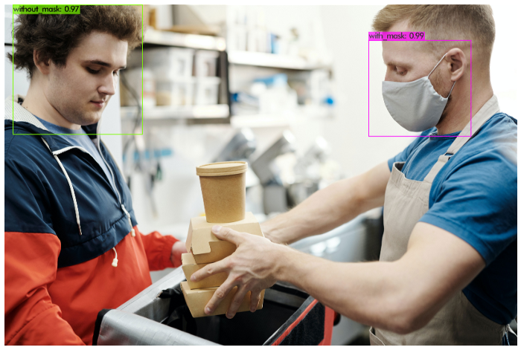
Mask Detection

Slide 32
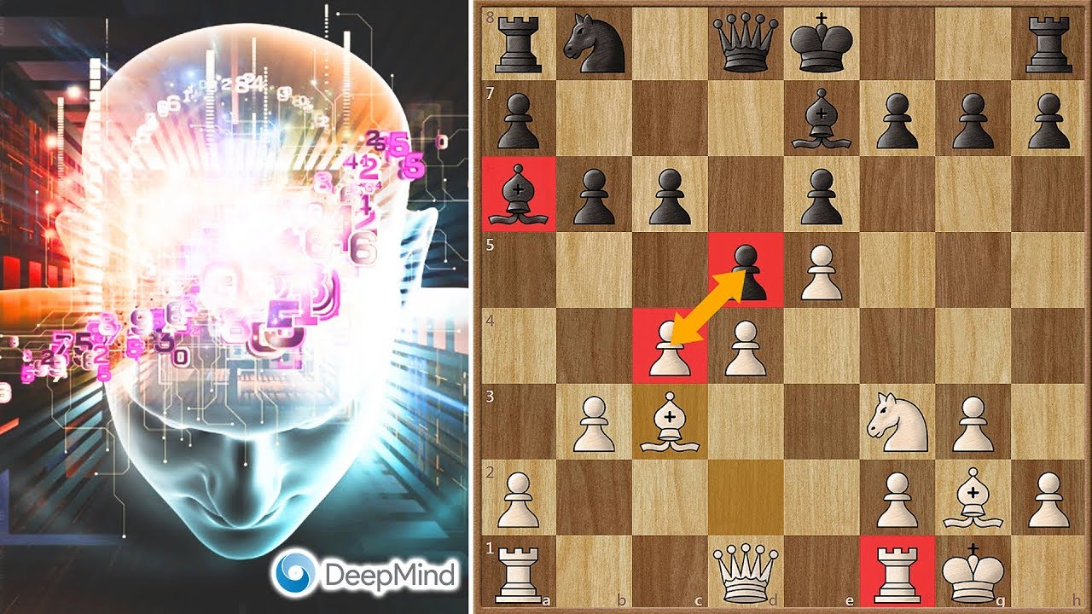
DeepMind Chess
Notes:
AlphaGo is the first computer program to defeat a professional human Go player, the first to defeat a Go world champion, and is arguably the strongest Go player in history.

Slide 33
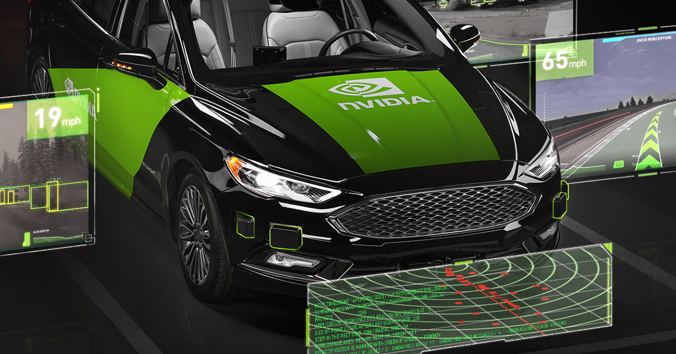
nVIDIA Driverless Cars

Slide 34
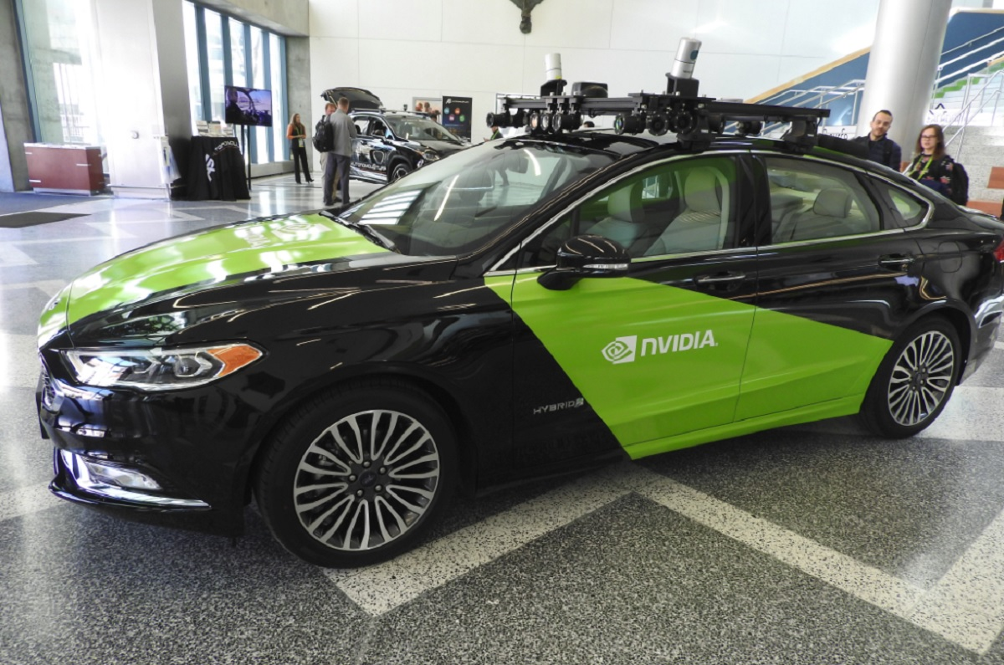
nVIDIA Driverless Cars

Slide 35
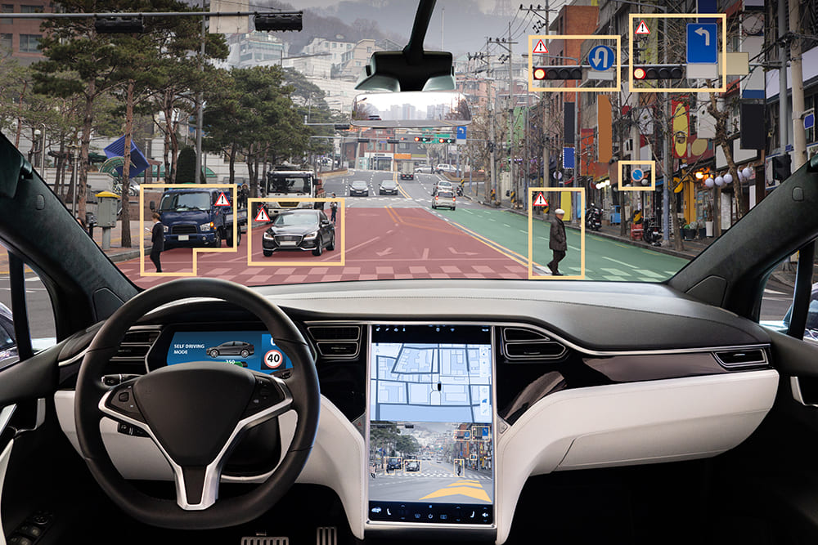
Tesla Autopilot

Slide 36
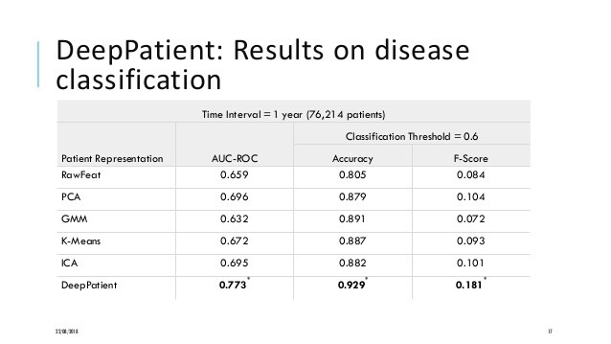
DeepPatient Algorithm

Slide 37
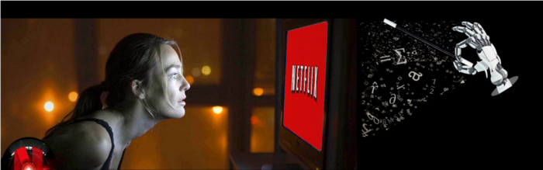
Netflix Recommendation System

Slide 38
End of the Week…

